Slide 1
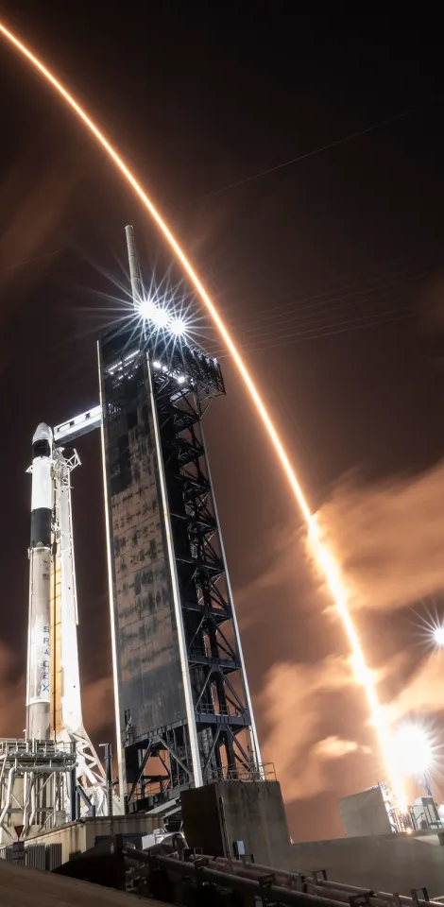

SpaceX Falcon 9
First Stage Landing Prediction
Name: Henry Suárez
Date: 02/10/24

Slide 2
outline
Executive Summary
Introduction
Methodology
Conclusion
Appendix

Slide 3
Executive Summary
We will be working with SpaceX launch data obtained from the SpaceX REST API. This API provides comprehensive information about launches, including details about the rockets used, payloads delivered, launch specifications, landing requirements, and landing outcomes. Our objective is to analyze this data to predict whether SpaceX will attempt to land a rocket.

Slide 4
Introduction
Background and Context
SpaceX advertises Falcon 9 rocket launches on its website for a cost of $62 million, while other providers charge upwards of $165 million for similar services. A significant portion of these savings can be attributed to SpaceX's ability to reuse the first stage of the rocket. Consequently, if we can accurately predict whether the first stage will successfully land, we can better estimate the overall cost of a launch.
Problem
The goal is to train a machine learning model using publicly available information to predict whether SpaceX will reuse the first stage of the Falcon 9 rocket.

Slide 5
Methodology
Data Collection Methodology
Data Wrangling: Clean and preprocess the collected data to ensure it is structured and ready for analysis.
Exploratory Data Analysis (EDA): Conduct EDA using visualizations and SQL queries to uncover insights and patterns within the data.
Interactive Visual Analytics: Utilize Folium and Plotly Dash to create interactive visualizations that enhance data exploration and understanding.
Predictive Analysis: Apply classification models to perform predictive analysis, enabling us to forecast outcomes based on the data.

Slide 6
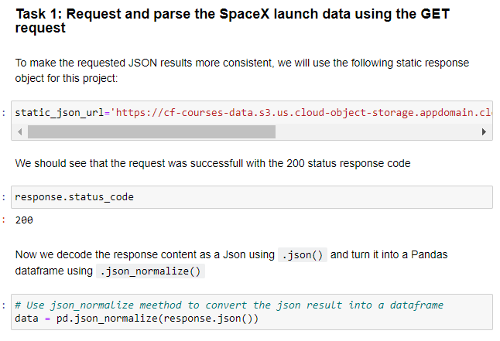
Data collection
SpaceX REST API :
Data collected using SpaceX API

Slide 7
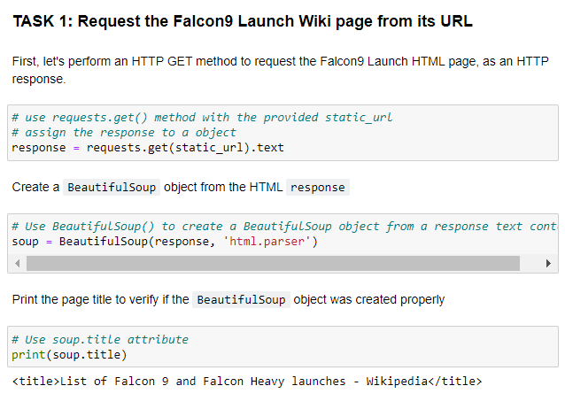
Data collection
Web scrapping data from Wikipedia using BeautifulSoup

Slide 8
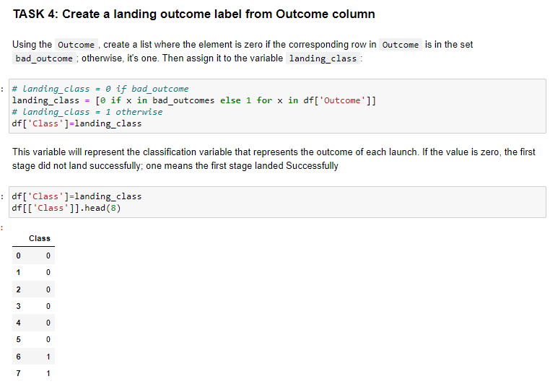
Data Transformation: Convert the data into a more usable format for analysis.
Label Definition: Define the training label, where 1 indicates that the booster successfully landed and 0 indicates an unsuccessful landing.
Feature Engineering: Prepare the data through feature engineering to enhance the predictive power of the model.
Data wrangling
Convert data into a more usable form
Determine training label ( 1 means the booster successfully landed, 0 means it was unsuccessful)
Preparing data feature engineering

Slide 9
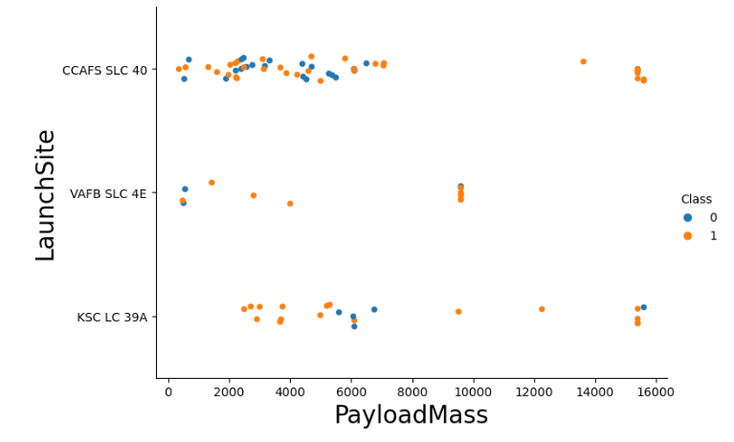
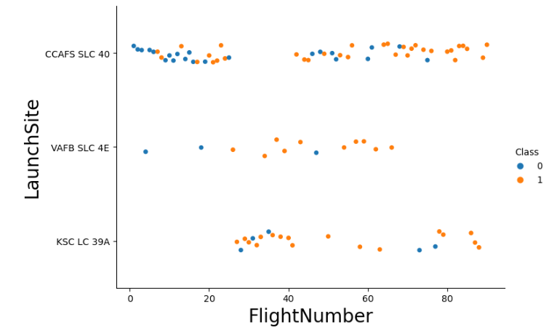
EDA with Data Visualization
Exploratory data analysis
Preparing data feature engineering

Slide 10
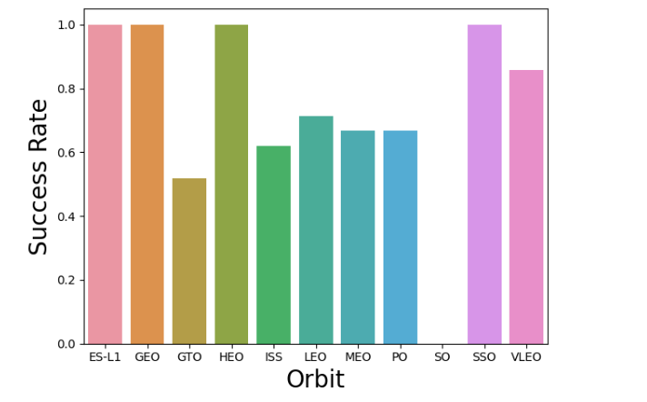
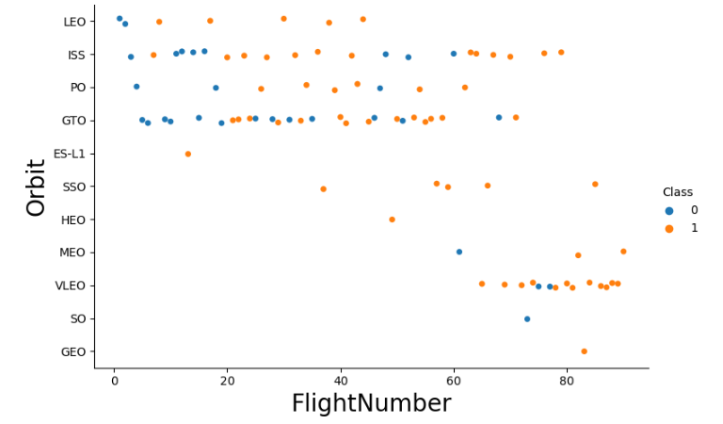
EDA with Data Visualization (Cont.)

Slide 11
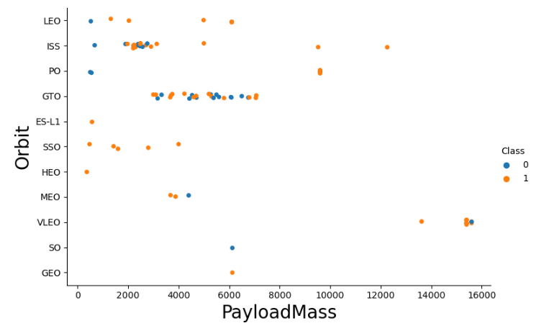
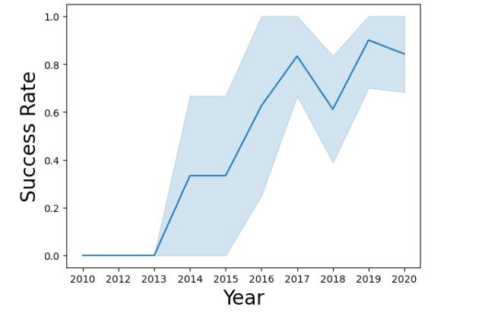
EDA with Data Visualization (Cont.)

Slide 12
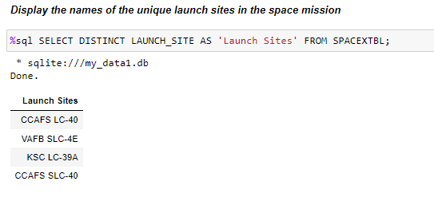
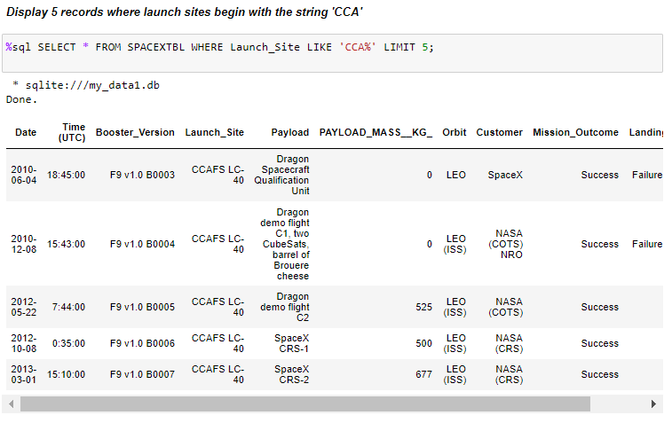
EDA with SQL
Execute SQL queries to answer questions

Slide 13
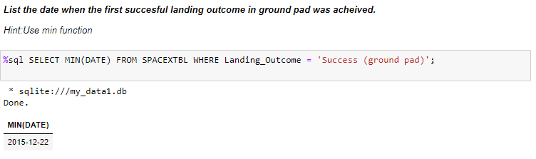
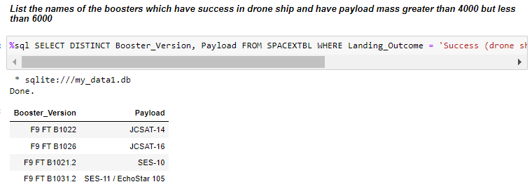
EDA with SQL (Cont.)

Slide 14
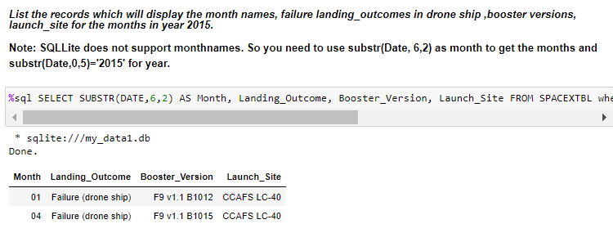
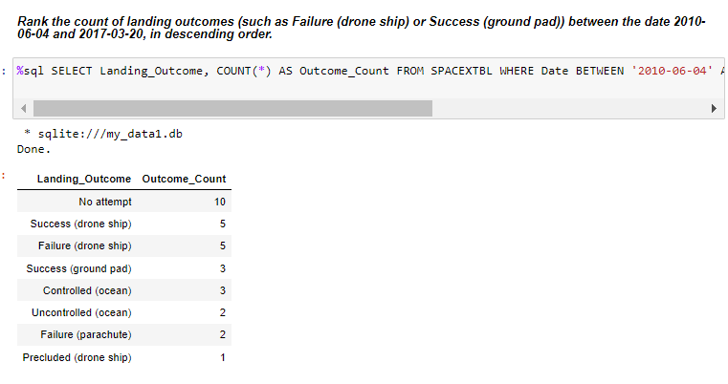
EDA with SQL (Cont.)

Slide 15
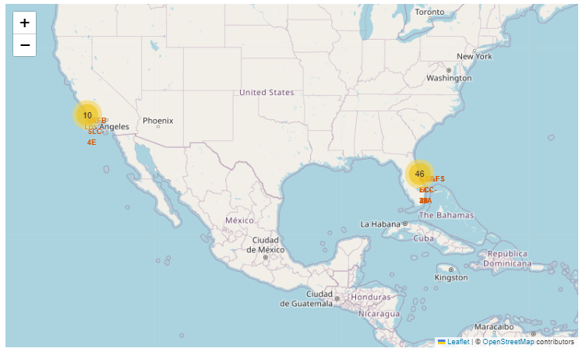
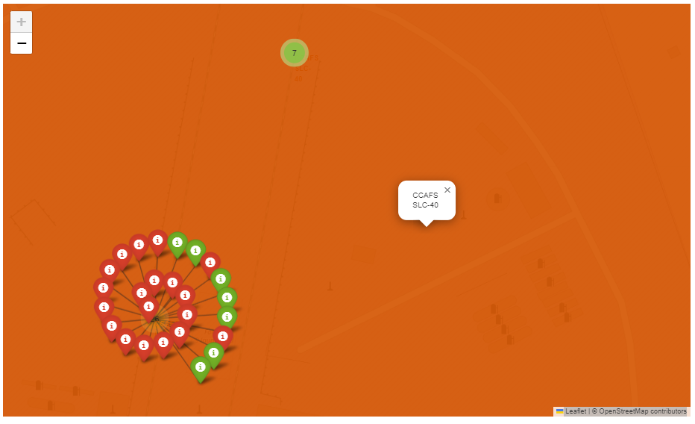
Interactive visual anaytics using Folium
FLaunch Sites
FFlorida Launch Sites

Slide 16
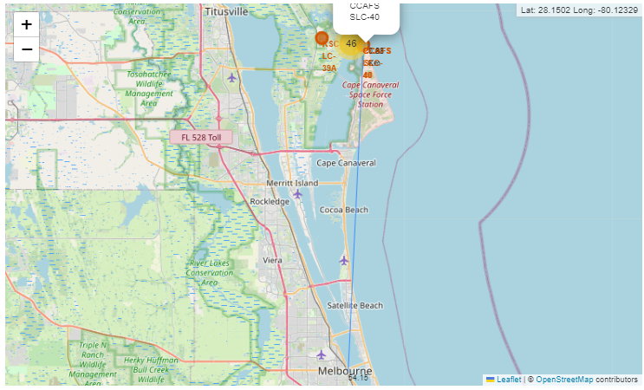
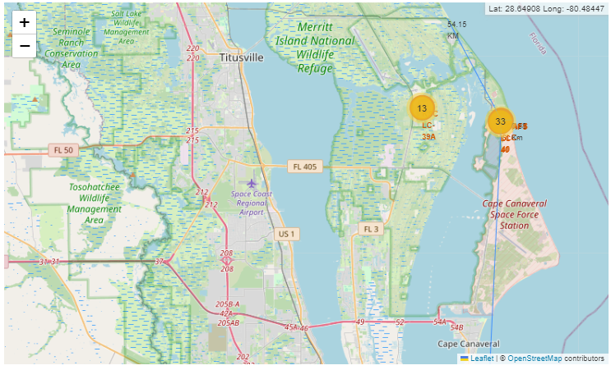
Interactive visual anaytics using Folium (Cont.)
Proximity of Locations

Slide 17
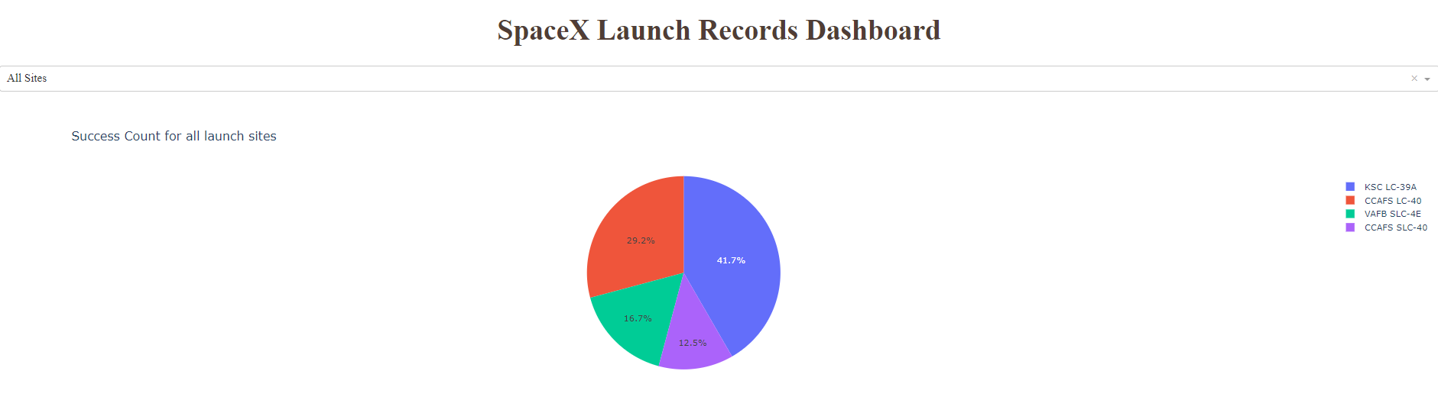
Interactive visual anaytics using Plotly Dash

Slide 18
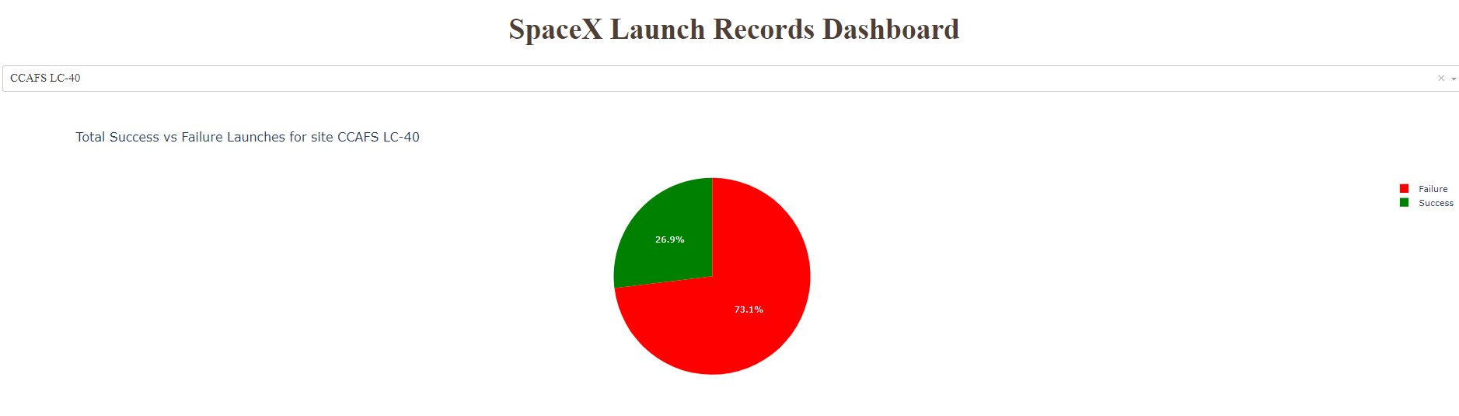
Interactive visual anaytics using Plotly Dash

Slide 19
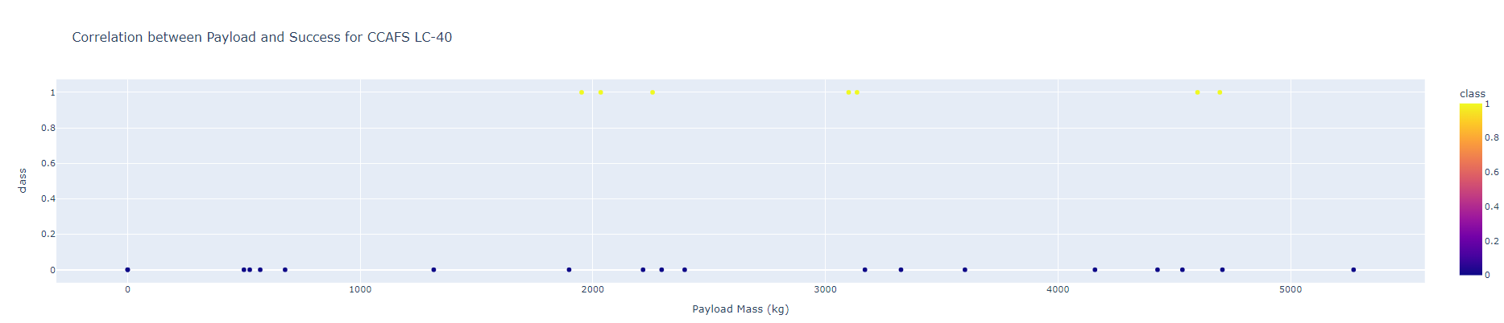
Interactive visual anaytics using Plotly Dash

Slide 20
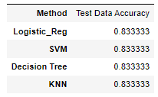
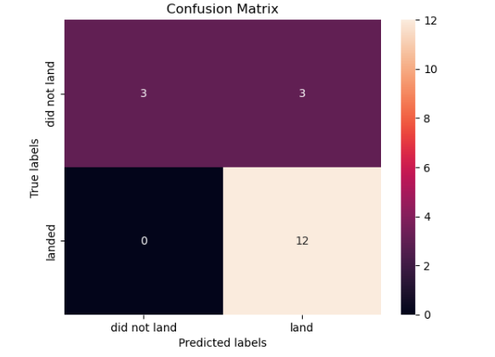
Predictive analysis using classification models

Slide 21
Conclusion
We built four ML models: Logistic Regression, SVM, Decision Tree, and KNN.
All models achieved an identical accuracy of 83.33% on the test data.
Orbits ES-L1, GEO, HEO and SSO have the highest success rates, while SO orbit has the lowest.
The success rate for the LEO orbit appears to be related to the number of flights.

Slide 22
apendix
GitHub repository
https://github.com/Kata10/Predicting-Falcon-9-First-Stage-Landing-Success

